Slide 1
FMHC E-Learning
Student Guide On how to access and Learn Online

Slide 2
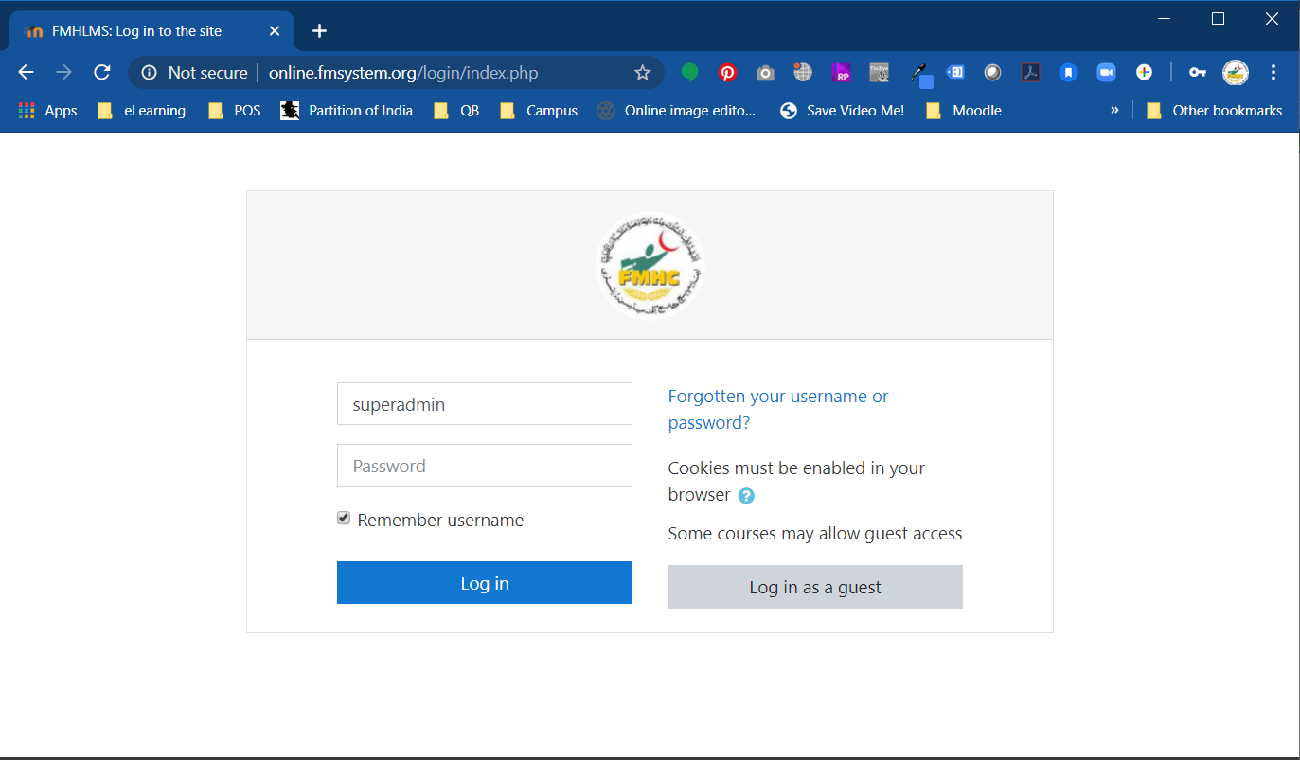
Access the Portal
http://online.fmsystem.org/login/index.php
Go to the above mentioned link
Enter your User name
Enter your password
Click on Login
After the login you will move to main dashboard
NOTE:
For Username and password contact student affairs department Or MIS

Slide 3
The Header
Menu
Profile
You can edit your name and change password etc.

Slide 4
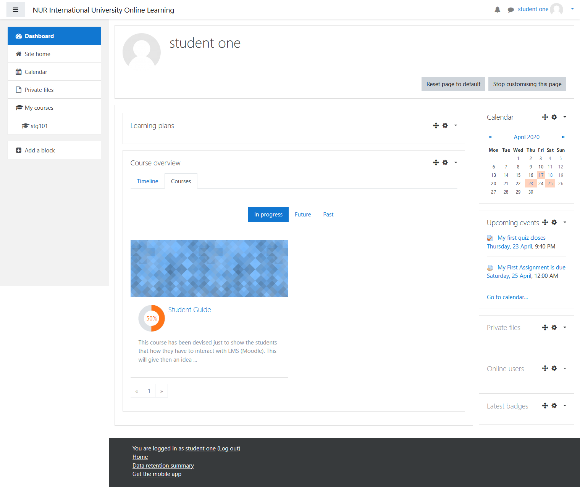
The Dashboard
Calendar – showing important dates
YOU WILL VIEW YOUR
COURSES IN THIS SECTION
CLICK NAME OF COURSE TO OPEN IT
Upcoming events such as lecture, assignment or quiz

Slide 5
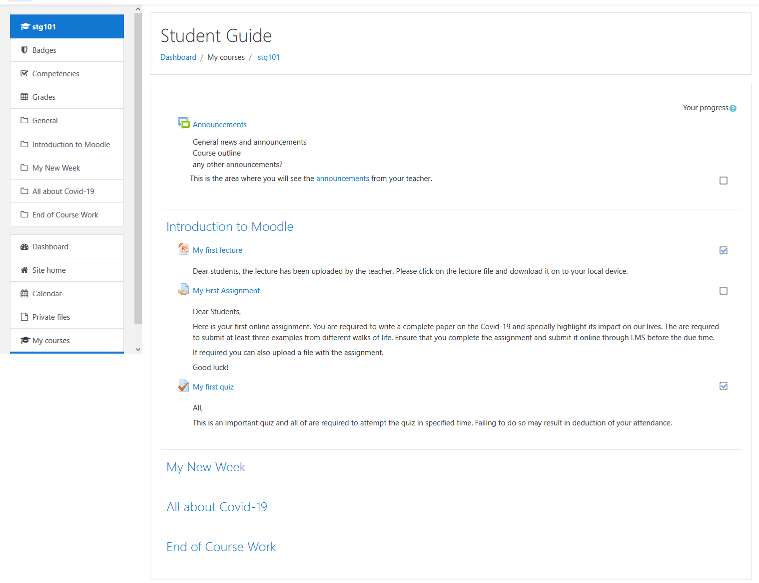
The Course Page
Name of Course
Announcements from teacher / management
Contents of the lectures e.g. lecture as ppt, Assignment and Quiz … this section will keep on growing downwards with new contents ,,,,

Slide 6
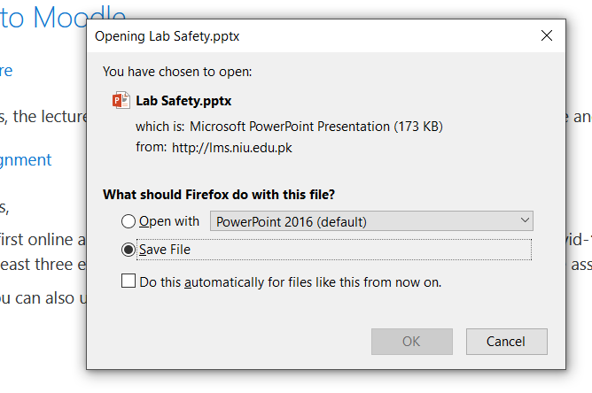
Reading Lecture
Click on the lecture / link
Select the option Save File and Click on OK to download the File

Slide 7
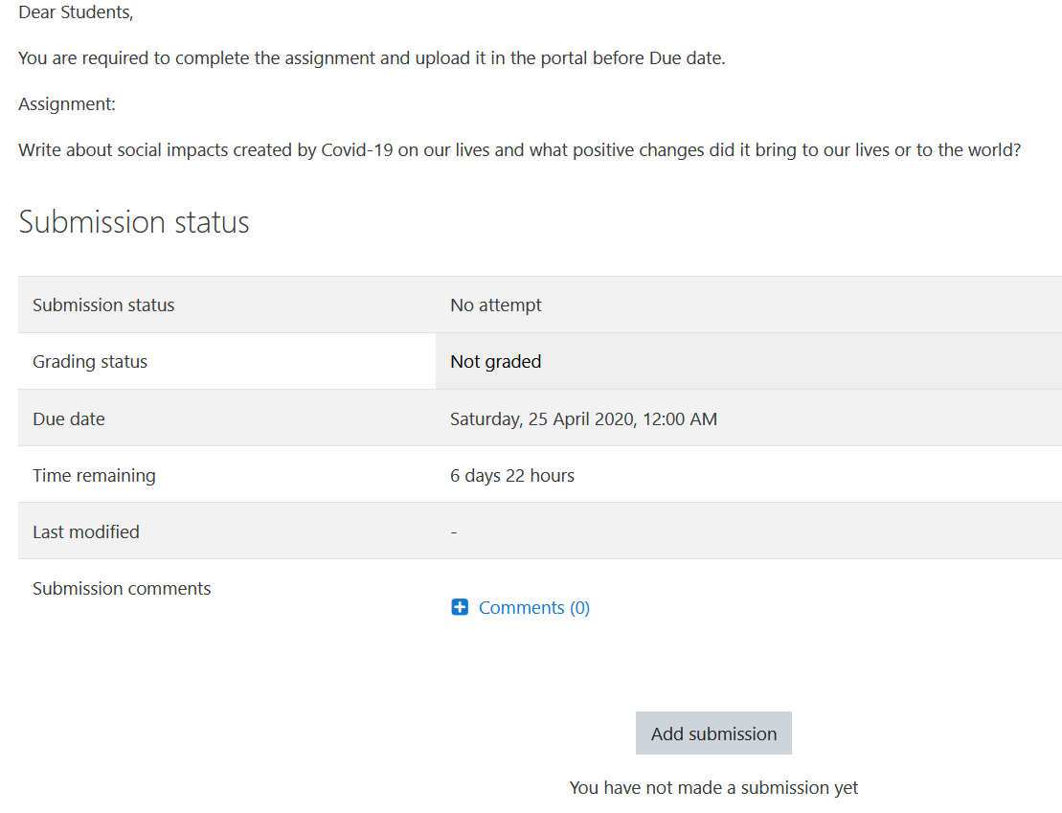
Submit Assignment
2. A new page will open
1. Click on the Assignment
3.
Click on the button “Add Submissions” a new page will open

Slide 8
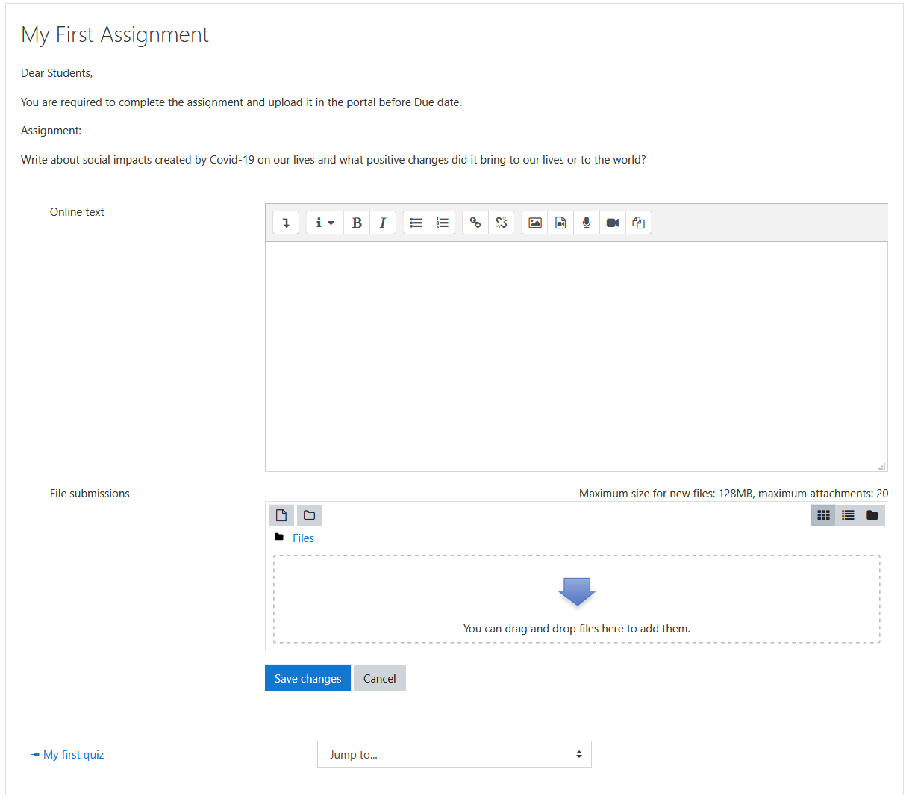
Submit Assignment ..
You can write the answer in this section. If required you teacher may not show this area instead he would ask you to upload a file
You can upload a file (Word, pdf, ppt, excel) and then click Save Changes

Slide 9
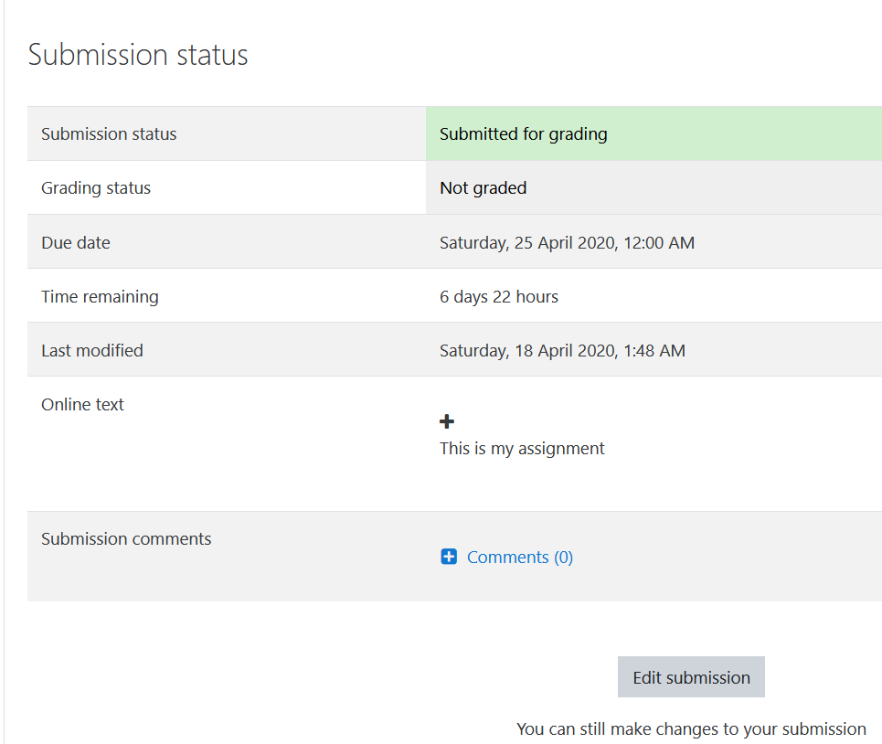
Submit Assignment
You will see the message that your assignment has been submitted.
You can still Edit your submission until the Due Date is over.

Slide 10
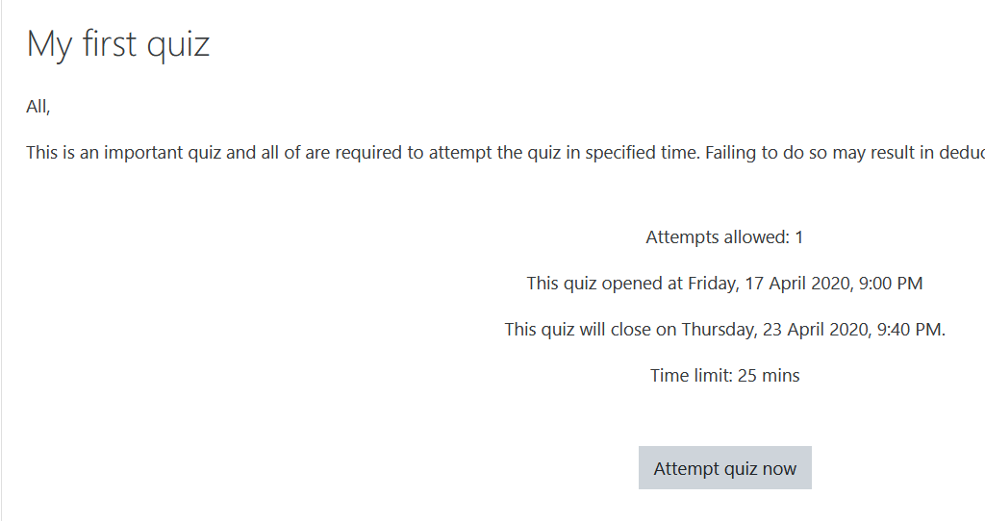
Attempt a Quiz
Click on the Quiz
Note:
Students will not be able to start the quiz before the allowed time.
Start the Quiz

Slide 11
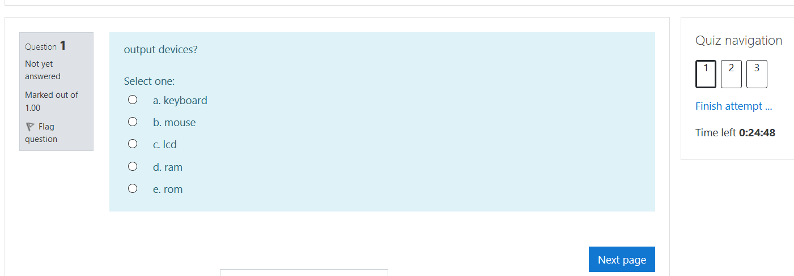
The Questions
Showing total number of questions. You can click on number of question to view it as well
Select correct option
Text of question
Move to next question
Note: You can skip a question and move to next page. Later you can come back to Answer the question that you have skipped.

Slide 12
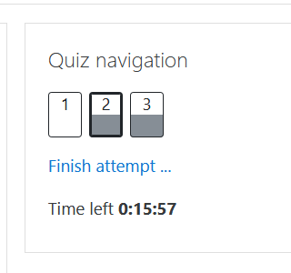
Explanation on Quiz
Shows Not attempted question
Shows attempted question
Finish the attempt of Quiz .. This will end your session

Slide 13
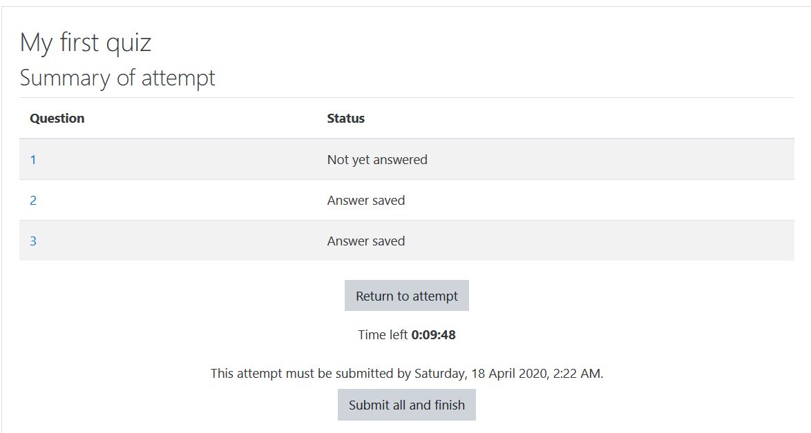
The end of Quiz
Student can go back to attempt questions. Unless Time is over
Shows the behavior of the students attempt
Student must click this button to end the session

Slide 14
Some Instructions
Change you password and keep it safe with you
If someone uses your password to submit assignment or quiz, the institute will not take responsibility of misbehave, wrong answers any other wrong doing on part of you. You will be considered as responsible for such events.
You have to ensure that you don’t wait until the end of time to submit assignments, you should do it as soon as possible to avoid any mishaps / accidents such as non availability of electricity or internet.
In case you forget your password, contact Student Affairs department Or MIS department with a valid identity

Slide 15
Thank you
Do you have any questions?

